Slide 1

Intelligent Control
Enabling safety at speed
Leanne Bridges Chief Product Owner: Intelligent Control, Nationwide Building Society
Mark Rendell DevOps and SRE Consultant, Nationwide Building Society

Slide 2

Agenda
Nationwide Building Society overview
What we needed
What did and what we’ve learnt

Slide 3
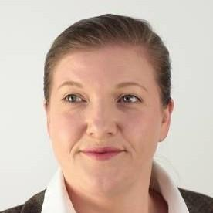
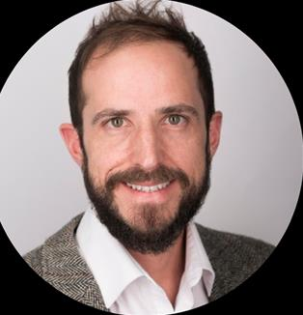
Who we are
Leanne Bridges
@MarkosRendell
Intelligent Control
DevOps
Ways of Working

Slide 4

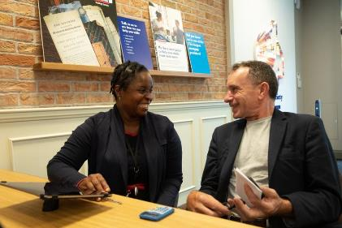


About Nationwide
We’re the world’s largest Building Society, the UK’s second largest mortgage provider, and one of the UK’s largest savings providers.

Slide 5








Firstly, a bit about Nationwide…
No.1
for customer satisfaction amongst our peer group
We’re the world’s largest building society, the UK’s second largest mortgage provider, and one of the UK’s largest savings providers.
Backing our high streets and communities with branch promise until 2023
16.3 million members
UK’s
most trusted financial brand
Created a £1 billion loan fund to incentivise greener homes
Helped 1 in 6 first time buyers into their first home
Banking Brand of the year 2020
for the fourth year
These statistics are taken from our September 2020 Interim Results

Slide 6





Our rationale and response to change
Bring together multi-functional teams with a shared purpose
Keep relevant and competitive
Deliver value sooner, enabling more from start to finish
Create focus on new capabilities to enable long-term strategic development of the Society

Slide 7

Not a why/how DevOps talk
We assume you already:
have a vision of what “cool” looks like
have some pockets of great success
are sure you want to scale things up

Slide 8

Enabling and Encouraging DevOps with controls
Controls must:
be appropriate
have efficient processes
promote safe autonomy – accountable freedom

Slide 9

Agile Adolescents
Agile Adolescents :
Enthusiastic and ambitious
Progressively more consequences of actions
Like to challenge the status quo

Slide 10
Agile Adolescents
Agile Adolescents :
Enthusiastic and ambitious
Progressively more consequences of actions
Like to challenge the status quo
The guardians:
Still legally and morally accountable
Role has to evolve
Needs to enable autonomy

Slide 11
We knew several years ago that we needed to make changes…
Formal project methodology
Time

Slide 12
We knew several years ago that we needed to make changes…
Formal project methodology
Early Agile Successes
Time

Slide 13
We knew several years ago that we needed to make changes…
Formal project methodology
Adaptive Change Framework
Early Agile Successes
Time

Slide 14


We knew several years ago that we needed to make changes…
Formal project methodology
Adaptive Change Framework
…but throwing some wine out with the cork was not an option…
Early Agile Successes
Time

Slide 15
So tight controls persisted and even multiplied to fill a perceived void
Formal project methodology
Adaptive Change Framework
Standards
Guardrails
Checklists
Assessments
Early Agile Successes
Time

Slide 16
Enter “Intelligent Control”
Formal project methodology
Adaptive Change Framework
Standards
Intelligent Control Needed!
Guardrails
Checklists
Assessments
Early Agile Successes

Slide 17
What are Controls and Why do we need them?
Must do’s and should do’s
Architected to enabling accuracy, consistency, repeatability, traceability, transparency
Supporting traceability for those accountable
Controls
Standards
Policies
Compliance
Regulations
Rules

Slide 18







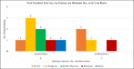





Our Solution
Building the Right Thing and Building It Right
ECF
Control Story Library
Product Backlog
Enterprise Control Framework
OKR
Unified Risk Assessment
Control Stories
Product Team, Safety Team and IC Support
Re-assessment of Risk as required

Slide 19
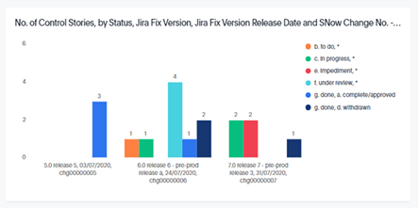
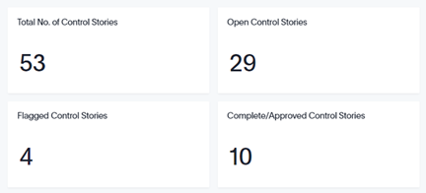
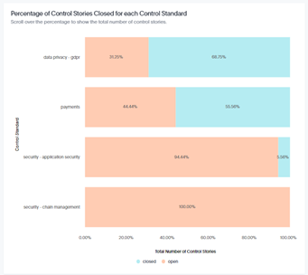
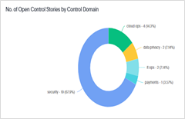
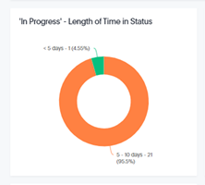
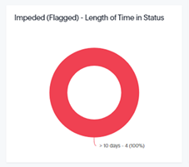
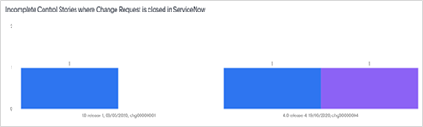
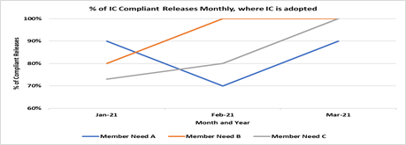
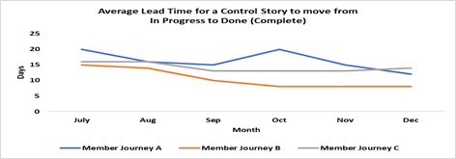
Enabling Transparency and Traceability
Test Data only for Demonstration purposes

Slide 20
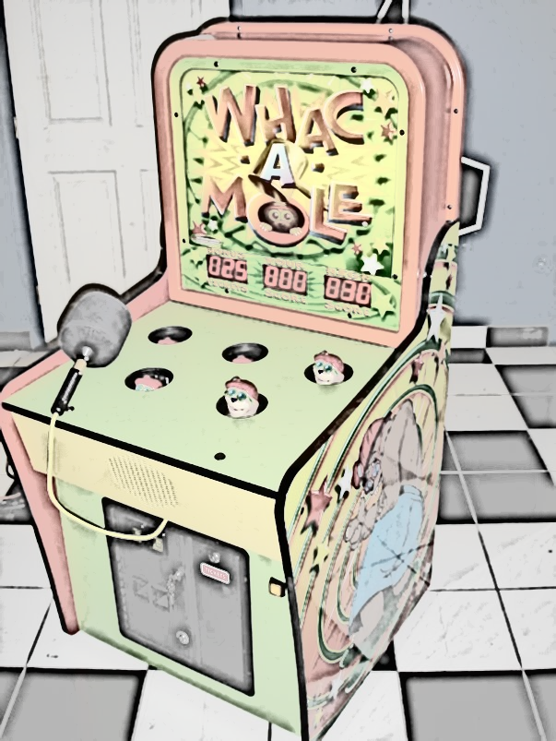
Lesson – Understand why processes and controls existed in the first place
Controls are the symptom of an underlying perceived need (perhaps a reaction to a past event)
What is that need and can we fully still meet it?
If we don’t think we need it, can we help others agree?

Slide 21

Lesson – Enterprise visible tickets really do work
Sometimes our tool is better than yours (if more people have access)
Just enough workflow and structured data capture
Simple reporting

Slide 22

Lesson – You can’t over communicate
Everyone will have their own ideas about what this means
It’s a complex field and jargon creates silos
Regular, bite size communication is key – and stakeholder advocates

Slide 23

Lesson - Acknowledge the unsafety
Empowerment can feel threatening
Help people adjust to their independence

Slide 24

Lesson – Sometimes it’s the user and not the controls
Teams may over-apply controls which they could have qualified out of
For example with code deployments, they may not realise how close they are to meeting the criteria to deliver as Standard Changes

Slide 25

Lesson – Intelligent Control is not such an Intelligent name
Who is intelligent?
Is this AI (it’s not AI)?

Slide 26

What’s next and where we’d like help
Learning from DevSecOps
Automation
Holistic view of control, security, reliability, and business value

Slide 27
Conclusion
Creativity can love constraints and DevOps can love Controls
Remember the teenager dynamic and that after all we’re a family
Standardising and streamlining controls is extremely powerful
It’s an ongoing journey not a destination!

Slide 28
Thanks!
Leanne Bridges
@MarkosRendell
Intelligent Control
DevOps
Ways of Working

